Slide 1
COMP 249:
Object Oriented Programming II
Chap 13 – Interfaces and
Nested Classes

Slide 2
Interfaces
A Java interface specifies a list of
  abstract methods (only their signatures, but no code)
  constants
A class implements an interface if it supplies code for all methods of that interface
A class can implement several interfaces

Slide 3
An Interface
None of the methods in
an interface are given
a definition (body)
interface is a reserved word
public interface Doable
{
public void doThis();
public int doThat();
public void doThis2(float value, char ch);
public boolean doTheOther(int num);
}
A semicolon immediately
follows each method header

Slide 4
An Interface
Methods in an interface have public visibility by default
A class implements an interface by
  stating so in the class header
  providing implementations for each abstract method in the interface
If a class implements an interface, it must define all methods in the interface
A class can implement multiple interfaces

Slide 5
A Class that Implements an Interface
implements is a
reserved word
public class CanDo implements Doable
{
public void doThis() {
// actual code
}
public void doThat() {
// actual code
}
public void doThis2(float value, char ch) {
// actual code
}
public boolean doTheOther(int num) {
// actual code
}
}
Each method listed
in Doable is
given a definition

Slide 6
Example
public interface Sellable {
public double getPrice ();
public void setPrice (double price);
}
public class GroceryItem implements Sellable {
private double myPrice;
< ... constructors and other methods >
public double getPrice() {
return myPrice;
}
public void setPrice(double price) {
myPrice = price;
}
}
Notes:
Different classes can implement the same interface in completely different ways.

Slide 7
Why Use Interfaces?
usually used common characteristics of otherwise unrelated objects
  ex: Integer, Double, Fraction, Polynomial… can all be compared
    compareTo()
  ex: Shoe, Telephone, Desk… can all be sold in a store
    computeTax(), getInventory(), …
  ex: Car, Lawnmower, Boat… all have engines
    consumeFuel(), boastEngine(), …
2 types of interfaces
  built-in: Comparable, Serializable, Cloneable …
  programmer defined

Slide 8
The Comparable Interface
The Comparable interface provides a common mechanism for comparing one object to another
if (obj1.compareTo(obj2) < 0)
System.out.println("obj1 is less than obj2");
The result is:
  negative if obj1 is less that obj2
  0 if they are equal
  positive if obj1 is greater than obj2

Slide 9
The Comparable Interface
public interface Comparable
{
/**
* Returns a positive integer if this is
* "greater than" other, a negative integer if
* this is "less than" other, and 0 if this is
* "equal" to other
*/
int compareTo(Object other);
}
Notes:
The compareTo method defines the ordering for the objects of a class. If defined, it is called natural ordering.
The parameter has the type Object, so that the signature of the compareTo method does not depend on a particular class. As a rule, other is an object of the same class whose compareTo is running and it is cast to that class type.

Slide 10
The Comparable Interface
«interface»
java.lang.Comparable
java.lang.String
java.lang.Integer
java.lang.Double
compareTo is based on lexicographical order
compareTo is based on numerical order
Notes:
Several library classes implement Comparable. Some library methods expect Comparable objects (e.g., Arrays.sort).

Slide 11
Sorting Anything Comparable
GeneralizedSelectionSort.java
ComparableDemo.java which uses the
GenerelaizedSelectionSort

Slide 12
An Interface is a Type
an interface is a type… so it can be used to specify a parameter to a method
More generic type of parameter --> more reusable code (works for any “Sellable” object)
public method calculateTax(Sellable obj, double rate)
{
return obj.getPrice() * rate;
}
GroceryItem apple = new GroceryItem("Apple", 0.30);
double tax = calculateTax(apple, 0.05);
ElectricalAppliance myDishWasher;
myDishWasher = new ElectricalAppliance("Maytag 123", 799.99, 220);
tax = calculateTax(myDishWasher, 0.07);
any class that implements the interface
Notes:
Many library methods (e.g., addActionListener) expect a parameter of an interface type. If my class implements that interface, I can pass an object of my class to the library method as an argument.

Slide 13
An Interface is a Type
an interface is a type… so it can be used to specify elements in a array
private Sellable[] items = new Sellable[3];
items[0] = new GroceryItem(...);
items[1] = new ElectricalAppliance(...);
items[2] = new JewelryItem(...);
Different types of objects are mixed together in the same array
Notes:
This is an occasion for polymorphism. The correct method will be called for each object in the array automatically.

Slide 14
Polymorphism via Interfaces
Polymorphic references are created in two ways:
  With class inheritance (seen already)
  With interfaces
With interfaces:
  Polymorphic reference can invoke any method defined by the interface
A powerful technique…
Can be used to provide generic processing for completely different things
Minimizes re-coding

Slide 15
Polymorphism via Interfaces
Assume we have:
    public interface CanTalk {
      public void speak();
      public void announce(String str);
    }
    …
    CanTalk a;
a can be used to point to any object of any class that implements the CanTalk interface
    a.speak();
The version of speak invoked depends on the type of object that current is referencing

Slide 16
Polymorphism via Interfaces
Assume we have this:
public class Philosopher implements CanTalk {…}
public class Dog implements CanTalk {…}
CanTalk guest = new Philospher();
guest.speak(); // phil's version of speak
guest = new Dog();
guest.speak(); // dog's version of speak

Slide 17
Converting between Types
Can convert from class type to interface type:
      Dog fido = new Dog("fido");
      CanTalk x = fido; // OK
Same interface type variable can hold a reference
to another class that implements the interface
      x = new Philosopher(); // OK
But cannot convert between unrelated types
      x = new Rectangle(5, 10, 20, 30); // ERROR

Slide 18

Casting
    Assume we have
    Can you do this?
    If you are wrong and max isn't a Dog, the runtime system throws an exception
public class Dog implements CanTalk {
  …
  public String getName();
}
CanTalk max = new Dog("max");
String name = max.getName();

Slide 19

Just checking:
ExampleCasting.java
interface Inflatable {}
class Balloon implements Inflatable {}
class PartyBalloon extends Balloon {}
class Pool implements Inflatable {}
Inflatable i = new Balloon();
i = new PartyBalloon (); // 1. OK?
Is valid
Results in compiler error
Results in runtime error

Slide 20
Just checking:
ExampleCasting.java
interface Inflatable {}
class Balloon implements Inflatable {}
class PartyBalloon extends Balloon {}
class Pool implements Inflatable {}
Balloon b = i; // 2. OK?
Balloon b = (Balloon) i; // 3. OK?
Is valid
Results in compiler error
Results in runtime error

Slide 21
Just checking:
ExampleCasting.java
interface Inflatable {}
class Balloon implements Inflatable {}
class PartyBalloon extends Balloon {}
class Pool implements Inflatable {}
PartyBalloon bb = (PartyBalloon ) new Balloon();
//4. OK?
Is valid
Results in compiler error
Results in runtime error

Slide 22
Just checking:
ExampleCasting.java
interface Inflatable {}
class Balloon implements Inflatable {}
class PartyBalloon extends Balloon {}
class Pool implements Inflatable {}
PartyBalloon bb2 = i; // 5. OK?
PartyBalloon bb3 = (Balloon) i; // 6. OK?
PartyBalloon bb4 = (PartyBalloon ) i; // 7. OK?
Is valid
Results in compiler error
Results in runtime error

Slide 23
Just checking:
ExampleCasting.java
interface Inflatable {}
class Balloon implements Inflatable {}
class PartyBalloon extends Balloon {}
class Pool implements Inflatable {}
i = new Pool(); // 8. OK?
b = new Balloon(); // 9. OK?
i = b; // 10. OK?
Is valid
Results in compiler error
Results in runtime error

Slide 24
Multiple Inheritance
Java does not allow multiple class inheritance
but…
Java allows multiple interface inheritance
syntax:
  public class aClass implements interface1, interface2 {…}
No conflicts possible. WHY?

Slide 25
Implementing Multiple Interfaces
A class can implement multiple interfaces
public class UsedCar implements Sellable, Comparable
{
private double myPrice;
<…constructors and other methods…>
public int compareTo(Object other) {
double diff = getPrice() - ((UsedCar)other).getPrice();
return (int)(100 * diff); // diff in cents
}
public double getPrice() {
return myPrice;
}
public void setPrice(double price) {
myPrice = price;
}
}
Notes:
The compareTo method is not required to return the actual “difference” between the objects. Try, for example,
Integer a = new Integer(100);
Integer b = new Integer(1);
System.out.println(a.compareTo(b));

Slide 26
Example
PhotoAlbum
int pictureCount; *
int pageCount;
getPageCount() setPageCount()
getPictureCount() * setPictureCount() *
Novel
int wordCount; *
int pageCount; *
getPageCount() *
setPageCount() *
ComicBook
needs:
int wordCount;
int pageCount;
int pictureCount;
getPageCount()
setPageCount()
getPictureCount()
setPictureCount()

Slide 27
A Bad Solution
PhotoAlbum
int pictureCount; *
int pageCount; *
getPageCount() setPageCount()
getPictureCount() * setPictureCount() *
Novel
int wordCount; *
int pageCount; *
getPageCount() *
setPageCount() *
ComicBook
inherit from Novel:
int wordCount;
int pageCount;
getPageCount()
setPageCount()
define own version of:
int pictureCount;
getPictureCount()
setPictureCount()
see InheritBad.java

Slide 28
A Better Solution
make it an interface
make it an interface
PhotoAlbum
// no attribute in an interface
getPageCount()
setPageCount()
getPictureCount() setPictureCount()
Novel
// no attribute in an interface
getPageCount()
setPageCount()
implements
implements
ComicBook
declare attributes:
int pictureCount;
int wordCount;
int pageCount;
implement methods:
getPageCount()
setPageCount()
getPictureCount()
setPictureCount()
see InheritGood.java

Slide 29
Abstract Classes Implementing Interfaces
Abstract classes can implement interfaces
A method heading in the interface that has no definition in the abstract class
  must be made abstract methods
  a concrete class must give definitions for all the method headings given in the abstract class and the interface
MyAbstractClass.java

Slide 30
Derived Interfaces
Like classes, an interface may be derived from a base interface
  This is called extending the interface
  The derived interface must include the phrase
    extends BaseInterfaceName
If a concrete class implements a derived interface
  must give definition for all methods
    in the derived interface
    and in the base interface
ShowablyOrdered.java

Slide 31
Constants in Interfaces
An interface can contain constants too
  Any variables defined in an interface must be:
    public, static, and final
  Because this is understood, Java allows these modifiers to be omitted
Any class that implements the interface has access to these defined constants
Is there really no conflict possible in multiple interface inheritance…?

Slide 32
Inconsistent Interfaces
When a class implements two interfaces:
  if the interfaces have constants with the same name…
  if the interfaces contain methods with the same name but different return types
public interface I1
{
int num = 1;
public int abc();
}
public interface I2
{
int num = 100;
public bool abc();
}
implements
implements
public class Mess implements I1, I2
{
. . . .
}

Slide 33
Just Checking
A class that uses an interface must use the keyword:
extends
inherits
super
implements

Slide 34
Just Checking
An interface may contain:
Instance variables
Primitive variables
Constant variables
All of the above

Slide 35
Just Checking
A class that implements an interface but only gives definitions for some of the method headings given in the interface is called a/an:
Concrete class
Discrete class
Abstract class
Friendly class

Slide 36
Nested Classes
If a class C1 is relevant only to another class C2,
  then we can define C1 within C2
this provides more information hiding and encapsulation.
    Ex:
      a Node class defined within a List class
      a Person class defined within an Account class
      a Money class defined within an Account class
used primarily in event-handling in GUI's

Slide 37
Nested Classes
class EnclosingClass {
…
  class NestedClass
  {
  …
  }
}
Enclosing Class
Nested Class
EnclosingClass.java
produces 2 class files
  EnclosingClass.class
  EnclosingClass$NestedClass.class

Slide 38
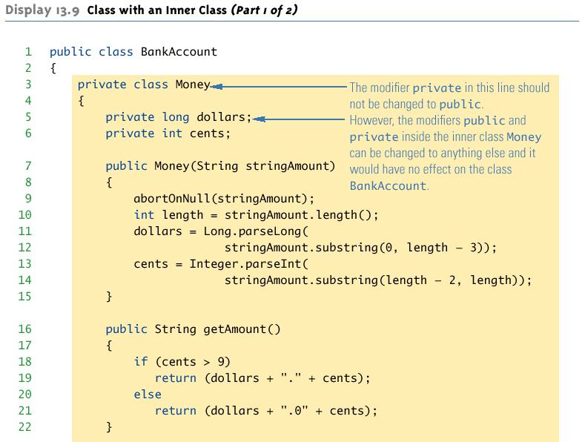
Example

Slide 39
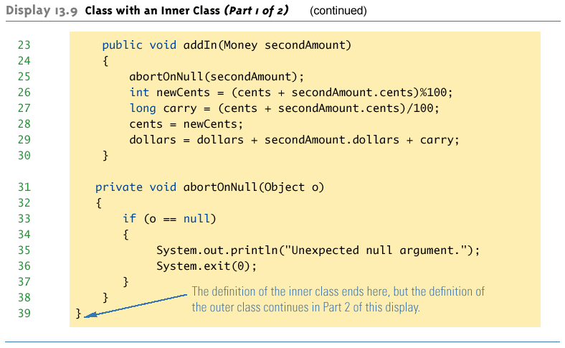
Example

Slide 40
Nested Classes
the nested class has access to:
  all members of the enclosing class, even if they are private
the enclosing class does not have access to:
  the private members of the nested class
nested classes can be declared as static
  in that case they can only refer to static members
a non-static nested class is called an inner class

Slide 41
Nested Classes
an inner class can be public or private
an inner class is usually only designed to be used within the enclosing class.
to provide information hiding, inner classes are usually private.

Slide 42
Example 2
class BankAccount { // outer class
private double balance;
private Client owner;
public BankAccount() {
balance = 0;
owner = new Client("ted", 666);
}
public void someMethod() {
System.out.print(balance + " " + owner.name);
System.out.print(owner.ssn);
}
private class Client { // inner class, can only be accessed in BankAccount
public String name;
private int ssn;
public Client(String name, int ssn) {
this.name = name;
this.ssn = ssn;
}
public void someMethod() {
System.out.print(balance + " " + name);
}
}
}

Slide 43
Simple Uses of Inner Classes
An inner class is a member of the outer class
  just like an instance variables is a member
  An inner class is local to the outer class definition
  If the inner class is private, then the inner class cannot be accessed by name outside the definition of the outer class
The name of an inner class may be reused for something else outside the outer class definition

Slide 44
Simple Uses of Inner Classes
2 main advantages of inner classes
  can make the outer class more self-contained
  Both of their methods have access to each other's private methods and instance variables
Typically used when the inner class is a helping class to the outer class
  then make the inner class private

Slide 45
Calling Methods of the Outer Class
If a method is invoked in an inner class:
  If the inner class has no such method
    then the method is searched in the outer class
  If both the inner and outer class have a method with the same name,
    then the method of the inner class is used
    to force the call the method of the outclass class:
    OuterClassName.this.methodName()

Slide 46
Inner Classes and Inheritance
Given an OuterClass that has an InnerClass
  Any DerivedClass of OuterClass will automatically have InnerClass as an inner class
  In this case, the DerivedClass cannot override the InnerClass
An outer class can be a derived class
An inner class can be a derived class also

Slide 47
Anonymous Classes
If an object is to be created, but there is no need to name the object's class
  then an anonymous class definition can be used
The class definition is embedded inside the expression with the new operator
AnonymousClassDemo.java
public static void main(String[] args){
NumberCarrier anObject =
new NumberCarrier( ) {
private int number;
public void setNumber(int value) {
number = value;
}
public int getNumber( ){
return number;
}
};
…

